Slide 1
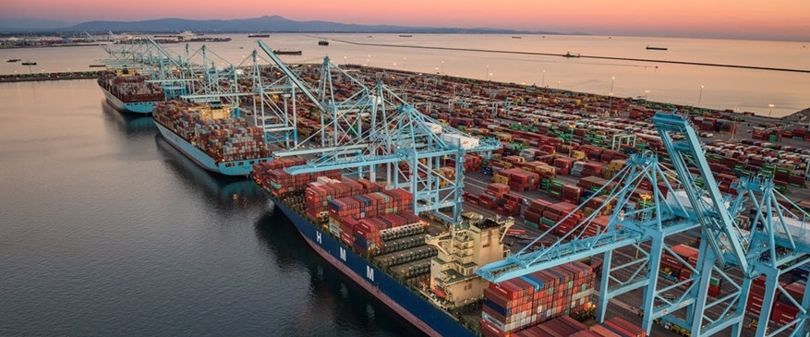
Digital Bunker Prices:
Reasons, Mechanism, Benefits 2021-06-24
Digital Bunker Price Presentation

Slide 2
Digital Bunker Prices: Reasons Mechanism Benefits

Slide 3
Digital Bunker Prices Reasons
A tool to make Bunker Price Mechanism more transparent: created from a much broader source of information
Price adjustments to Bunker Market’s volatility
instantly
Completely independent
Free from price manipulations
RESULT = FAIR BUNKER PRICES!
REASONS

Slide 4
Digital Bunker Prices Mechanism
MABUX has invented a parallel bunker market:
DIGITAL BUNKER MARKET
It relates entirely to Oil Future differentials - giving
DIGITAL BUNKER PRICES (DBP)
MECHANISM

Slide 5
Digital Bunker Prices Mechanism
MABUX suggests:
Firstly: Digital Bunker Prices (DBP) should be the base for Market Bunker Prices (MBP).
The New Benchmark
Secondly: Local Market Bunker Prices to be given a chance to influence the DBP (if needed?)

Slide 6
Digital Bunker Prices Mechanism
Oil Futures table
Digital Bunker Prices (DBP) are connected to Oil Future
differrentials and updated every minute in our model.
Products available and suitable for DBP: 380 HSFO, VLSFO and MGO (Marine Gasoil).

Slide 7
Rotterdam MBP/DBP price curves covering 12 months date spread, VLSFO
Digital Bunker Prices Benefits
MBP

Slide 8
Rotterdam MBP/DBP price curves covering 1 month date spread, VLSFO June 02, 2021
Digital Bunker Prices Benefits
MBP

Slide 9
PROOF 1A: OIL FUTURE DIFFERENTIALS BASE for Digital Bunker Prices
(CL3)
(CL4)
(CL5)
(CL2)
Digital Bunker Prices (DBP)
(CL0)
(CL1)
(OP1)
(OP2)
(OP3)
(OP4)
Market Bunker Prices (MBP)
OP = OPENING
CL = CLOSING
(OP5)
(OP6)
ORANGE Price Curve Based on 4 day’s CLOSING DIFFERENTIALS (DBP) OK
BLUE Price curve based on today’s OPENING DIFFERENTAILS (MBP) NO

Slide 10
PROOF 1B: OIL FUTURE DIFFERENTIALS BASE for Digital Bunker Prices
(CL0)
(CL1)
(OP4)
(OP5)
(OP6)
Market Bunker Prices (MBP)
(OP1)
(OP2)
(OP3)
Digital Bunker Prices (DBP)
(CL5)
(CL3)
(CL4)
(CL2)
OP = OPENING
CL = CLOSING
ORANGE Price Curve Based on 4 day’s CLOSING DIFFERENTIALS (DBP) OK
BLUE Price curve based on today’s OPENING DIFFERENTAILS (MBP) NO

Slide 11
Rotterdam MBP/DBP price curves covering 1 month date spread, VLSFO June 02, 2021
Digital Bunker Prices Benefits
MBP

Slide 12
Settlement (Closing Numbers), June 02

Slide 13
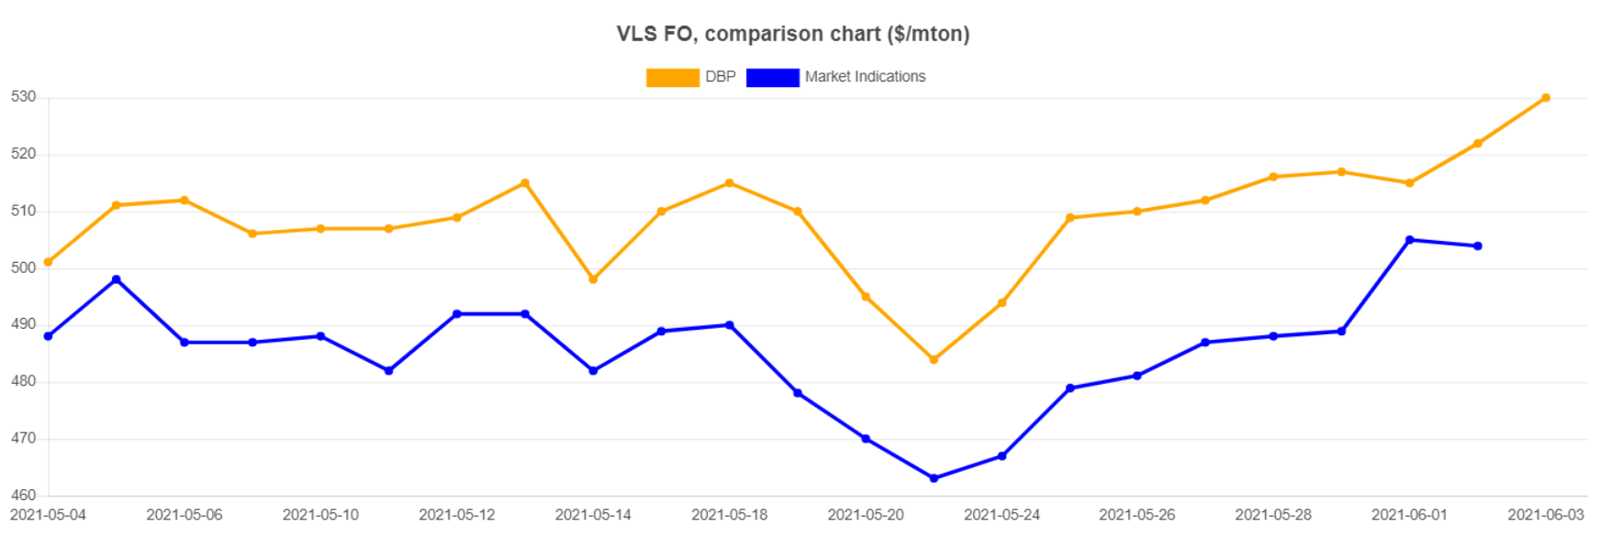
Rotterdam MBP/DBP price curves covering 1month date spread, VLSFO June 03, 2021
Digital Bunker Prices Benefits
MBP

Slide 14
Rotterdam MBP/DBP price curves covering 1month date spread, VLSFO June 03, 2021
MBP

Slide 15
Settlement (Closing Numbers), June 03

Slide 16
Rotterdam MBP/DBP price curves covering 1 month date spread, VLSFO June 04, 2021
Digital Bunker Prices Benefits
MBP

Slide 17
PROOF 2: FRONT MONTH CHANGE OIL FUTURES
June
= - 5 OK
= - 6 OK
= + 2
July

Slide 18
PROOF 3: CONVERSION Barrels to Mton CRUDE OIL/BRENT
Brent needs to be converted from USD/Barrel to USD/Mton.
A multiplier needs to be calculated and the multiplier is used
with the “CHANGE” taken from the Oil Future table.
As a Standard rule one can use a multiplier value of 6,
multiplying the ”CHANGE”.
Ex. 1 USD/Barrel change multiplied by 6 equals to 6 USD/Mton
380 HSFO approximately.

Slide 19
Rotterdam MBP/DBP curves 2 months, 380 HSFO
Digital Bunker Prices Benefits
Digital Bunker Prices Benefits
DBP
MBP
OVERCHARGED

Slide 20
Rotterdam MBP/DBP curves 2 months, MGO
Digital Bunker Prices Benefits
DBP
MBP
UNDERCHARGED

Slide 21
Overcharged and Undercharged
Digital Bunker Prices Benefits
in the past
Shipowners have been overcharged about 70%*
Suppliers have been undercharged about 30%*
*Prices measured for the period 1st January, 2018 until 31st December 2019.

Slide 22
MABUX GLOBAL BUNKER PRICES
DIGITAL HYSICAL
MABUX founded year 2000

Slide 23
CARL-JOHAN GARSTEN
MANAGING DIRECTOR
Marine Bunker Exchange (MABUX) AB
Kullagatan 6, SE-25220,
Helsingborg,
Sweden
Tel: +46 42 140430
Mob: +46 705 54 33 80
E-mail: info@mabux.com
Website: www.mabux.com
Website: www.mabux.ru

